Slide 1

Custom MATLAB Functions
Professor Bo Liu
James Watt School of Engineering

Slide 2


Built-in functions reminder
MATLAB has many built-in functions.
To call a mathematical function, enter the function name, then the input/argument in parentheses.
For example sin of π/2:
The input to the function
The name of the function to be called
See live script

Slide 3
MATLAB functions
You can write your own custom functions.
  Modular,
  Reusable,
  Easier to debug.
The custom function is written inside a separate .m file, or at the bottom of a script.
Inside a function you can write MATLAB code as usual.
Inside a function, the only available variables are the inputs (arguments) and variables defined inside the function.
  Effectively the function has its own separate workspace.

Slide 4
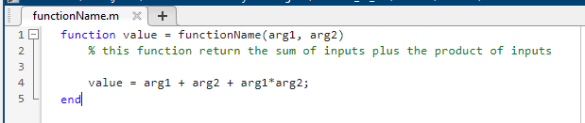
MATLAB functions
Function declarator
Variable to return
Function name
Input arguments
Function body
Function end
Separate file
“function” is used to indicate that this is a function definition.

Slide 5
MATLAB functions
Function declarator
Variable to return
Separate file
Function declarator
Variable to return
Function name
Input arguments
Function name
Input arguments
Function body
Function end
Function body
Function end
Separate file
The variable that will be returned to the calling code.

Slide 6
MATLAB functions
Function declarator
Variable to return
Separate file
Function declarator
Variable to return
Function name
Input arguments
Function name
Input arguments
Function body
Function end
Function body
Function end
Separate file
The name under which the function can be called.

Slide 7
MATLAB functions
Function declarator
Variable to return
Function name
Input arguments
Function body
Function end
Separate file
Inputs to function,
Function is not be able to access any other variables from the calling code.

Slide 8
MATLAB functions
Function declarator
Variable to return
Separate file
Function declarator
Variable to return
Function name
Input arguments
Function name
Input arguments
Function body
Function end
Function body
6. Function end
Separate file
Where the MATLAB code goes.
The return variable needs to be assigned here.

Slide 9
MATLAB functions
Function declarator
Variable to return
Separate file
Function declarator
Variable to return
Function name
Input arguments
Function name
Input arguments
Function body
Function end
Function body
Function end
Separate file
Indicate end of function.

Slide 10
MATLAB functions
Separate file
Function declarator
Variable to return
Separate file
Function declarator
Variable to return
Function declarator
Variable to return
Function name
Input arguments
Function name
Input arguments
Function name
Input arguments
Function body
Function end
Function body
Function end
Function body
Function end
Separate file
File should be saved as the name of the function followed by “.m”

Slide 11
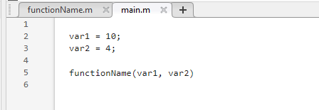
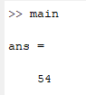
Calling the custom function
You can now call the custom function exactly like any other MATLAB function.
Enter the function name, followed by the inputs in paratheses.
The inputs to the function
The name of the custom function
See MATLAB files

Slide 12
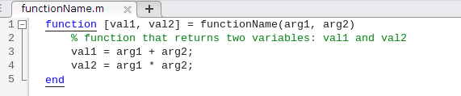
MATLAB function with multiple outputs
Sometimes it is desirable to return multiple values from a function
The second returned values could be very useful
  Some MATLAB built-in functions have optional additional returned values.
  For example, the max() function returns the maximum value in the input and optionally also returns the index of the maximum value.
To return multiple values from a MATLAB function, enter both variables' names in square brackets in the function declaration.
See MATLAB files

Slide 13
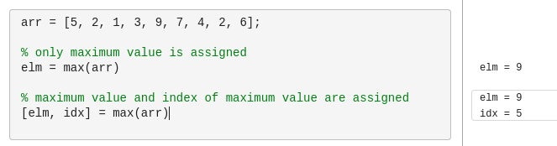
Calling MATLAB functions with multiple outputs
If the result of a function that has multiple returned values is assigned to a variable, then only the first returned value is used.
To access the other returned values, deconstruct the output using square brackets.
The highest number in the input array is 9 and it is found at index 5.
See live script

Slide 14
Common misunderstandings
Most MATLAB variables are passed to the function by value.
  A copy of the variable is made to pass to the function.
  Changes made to the copy do not affect the original variable.
A function cannot access variables that are not passed to it by function inputs.
  MATLAB functions have their own separate workspace (memory).
The name of the variable passed to the function can be different from the name of the variable inside the function definition.
See live script

Slide 15




Thanks!
#UofGWorldChangers
@UofGlasgow

